Slide 1
Faculty of Engineering and Technology
Busitema
University
Pursuing excellence
Group 17
MATLAB Group Assignment

Slide 2
Group 17 Members
Busitema
University
Pursuing excellence
Name | Reg Number | Program
AHAISIBWE CHRISTOPHER | BU/UP/2024/0824 | AMI
GIFT EMMANUEL | BU/X/2024/3250 | WAR
ADWONG CALEB | BU/UP/2024/3813 | MEB
MUWUBYA WYCLIFFE | BU/UP/2024/1045 | WAR
OWINO POSH | BU/UP/2024/1067 | WAR
ATATI EDWINE | BU/UP/2024/3730 | AMI
NABUKEERA ANNET RIONAH | BU/UG/2024/2676 | AMI
AHEREZA FAITH | BU/UG/2024/2673 | APE
OPOKA VINCENT | BU/UG/2024/2675 | AMI
AKELLO BARBRA | BU/UP/2024/1001 | WAR

Slide 3

MATLAB
QUESTION
In different groups, utilize the knowledge of algorithms development, control structures, control structures and modules 1 to 4 on the following problems:
All Numerical approximate methods for finding solutions to functions, these include but are not limited to New Raphson and secant method.
All methods for solving differential equations numerically these include but ae not limited to; Euler, Runge Kutta.
Ensure to apply a and b on a practical real world problem.
Note:
Requirements;
Ensure that different methods are stated on similar problems each (min 2). This will help you to plot graphs that compare the problems analytical solutions to the solutions obtained by the different methods along with the computation time.
GROUP 17

Slide 4
Root finding Methods for financial Modeling
codes
Problem
Find the interest rate that gives a future value of Ugx15,000,000.For investment of Ugx10,000,000 over 5 years with monthly compounding.
Using FV = PV * (1 + r/12)^(12*t)
% Problem: Find the interest rate that gives a future value of Ugx15,000,000
% for an investment of Ugx10,000,000 over 5 years with monthly compounding
% Where: FV = Future Value, PV = Present Value, r = interest rate, n =
% years, t = period
% FV = PV * (1 + r/12)^(12*t)
PV = 10000000; FV_target = 15000000; t = 5; n = 12;
Function
The function of the equation and its derivative
% Define the function
f = @(r) PV * (1 + r/n)^(n*t) - FV_target; %function
f_prime = @(r) PV * n*t * (1 + r/n)^(n*t - 1) / n; % derivative
GROUP 17

Slide 5
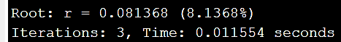
The Newton Raphson Method
fprintf('=== NEWTON-RAPHSON METHOD ===\n');
tic;
r0 = 0.05; % Initial value (5%)
tolerance = 1e-8; %accuracy(dps)
max_iter = 100;
errors_newton = zeros(1,max_iter); %array for storing the error outputs
for i = 1:max_iter
f_val = f(r0);
f_deriv = f_prime(r0);
r_new = r0 - f_val/f_deriv;
error = abs(r_new - r0);
errors_newton(i) = error;
if error < tolerance
break;
end
r0 = r_new;
iter0 = i;
end
time_newton = toc;
fprintf('Root: r = %.6f (%.4f%%)\n', r0, r0*100);
fprintf('Iterations: %d, Time: %.6f seconds\n', iter0, time_newton);
Initial setup: An initial value, a tolerance and maximum iteration are set.
Iteration: The loop calculates the next approximation the new root using the formula.
Convergence: The loop terminates when the error falls below the tolerance.
Output: It prints the calculated interest rate and performance metrics (iterations and time).
Print Results;
GROUP 17

Slide 6

2. SECANT METHOD
fprintf('=== SECANT METHOD ===\n');
tic;
r0_secant = 0.04; % First initial guess
r1_secant = 0.06; % Second initial guess
tolerance = 1e-8; % accuracy (dps)
max_iter = 100;
r_secant = [r0_secant, r1_secant];
errors_secant = [];
for i = 1:max_iter
f0 = f(r_secant(end-1));
f1 = f(r_secant(end));
if abs(f1 - f0) < eps
break;
end
r_new = r_secant(i+1) - f1 * (r_secant(i+1) - r_secant(i)) / (f1 - f0);
r_secant(i+2) = r_new;
error = abs(r_secant(i+2) - r_secant(i+1));
errors_secant(i:i) = error;
if error < tolerance
break;
end
end
time_secant = toc;
fprintf('Root: r = %.6f (%.4f%%)\n', r_secant(end), r_secant(end)*100);
fprintf('Iterations: %d, Time: %.6f seconds\n', length(r_secant)-2, time_secant);
The Secant method is a root-finding technique that approximates the derivative using a finite difference (the slope of the secant line) between two previous points
Print Results;
GROUP 17

Slide 7
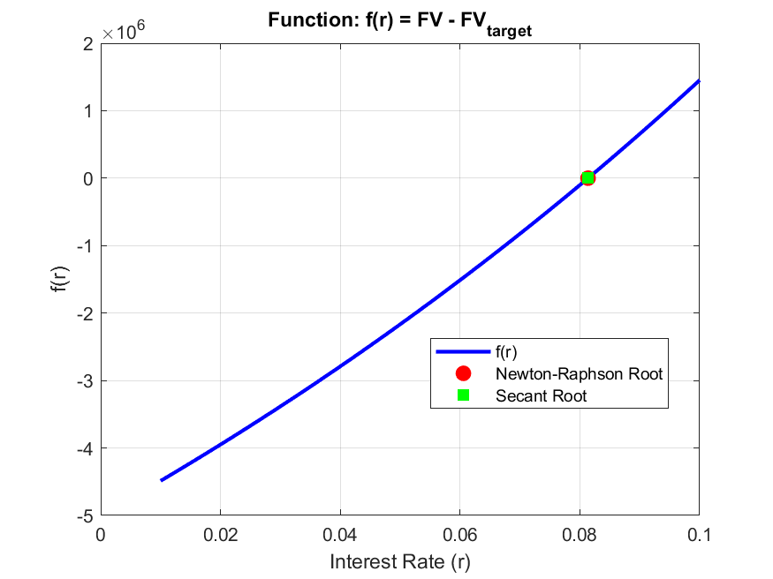
Visualization - Root Finding Comparison
figure;
% Function plot
r_range = linspace(0.01, 0.1, 100);
f_values = arrayfun(f, r_range);
plot(r_range, f_values, 'b-', 'LineWidth', 2);
hold on;
plot(r0, f(r0), 'ro', 'MarkerSize', 8, 'MarkerFaceColor', 'red');
plot(r_secant(end), f(r_secant(end)), 'gs', 'MarkerSize', 8, 'MarkerFaceColor', 'green');
xlabel('Interest Rate (r)');
ylabel('f(r)');
title('Function: f(r) = FV - FV_{target}');
legend('f(r)', 'Newton-Raphson Root', 'Secant Root', 'Location', 'best');
grid on;
GROUP 17

Slide 8
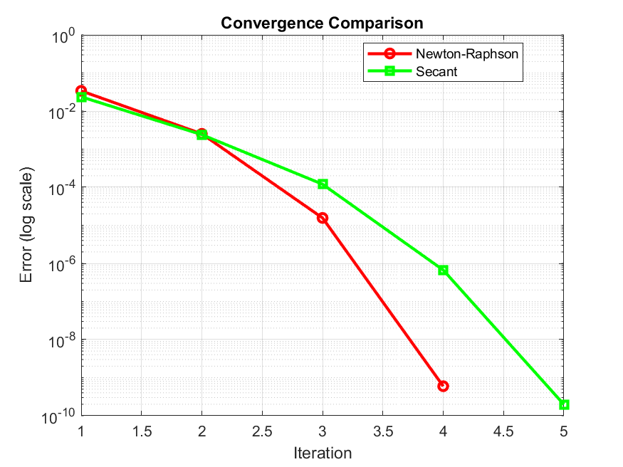
CONVERGENCE COMPARISON
figure;
semilogy(1:length(errors_newton), errors_newton, 'r-o', 'LineWidth', 2);
hold on;
semilogy(1:length(errors_secant), errors_secant, 'g-s', 'LineWidth', 2);
xlabel('Iteration');
ylabel('Error (log scale)');
title('Convergence Comparison');
legend('Newton-Raphson', 'Secant', 'Location', 'best');
grid on;
GROUP 17

Slide 9
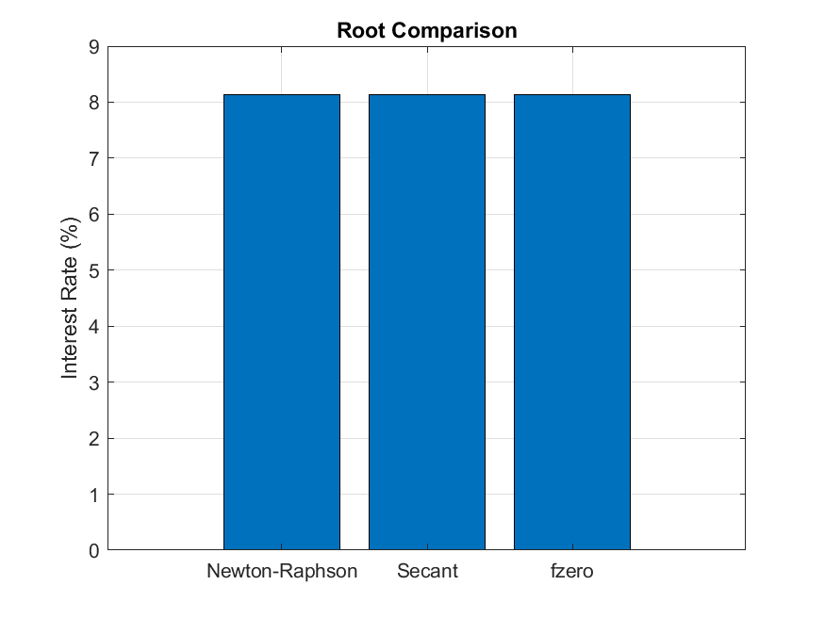
VERIFICATION
figure;
r_analytical = fzero(f, 0.05); % MATLAB's built-in function
methods = {'Newton-Raphson', 'Secant', 'fzero'};
roots = [r0, r_secant(end), r_analytical];
times = [time_newton, time_secant, 0.001]; % Approximate fzero time
bar(roots*100);
set(gca, 'XTickLabel', methods);
ylabel('Interest Rate (%)');
title('Root Comparison');
grid on;
GROUP 17

Slide 10
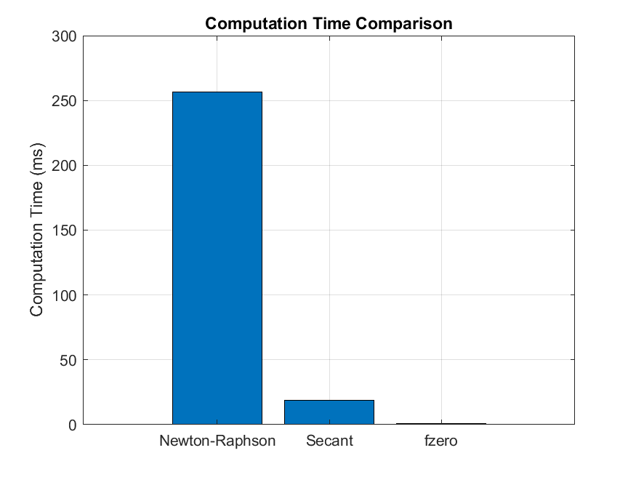
TIME COMPARISON
figure;
bar(times*1000); % Convert to milliseconds
set(gca, 'XTickLabel', methods);
ylabel('Computation Time (ms)');
title('Computation Time Comparison');
grid on;
GROUP 17

Slide 11
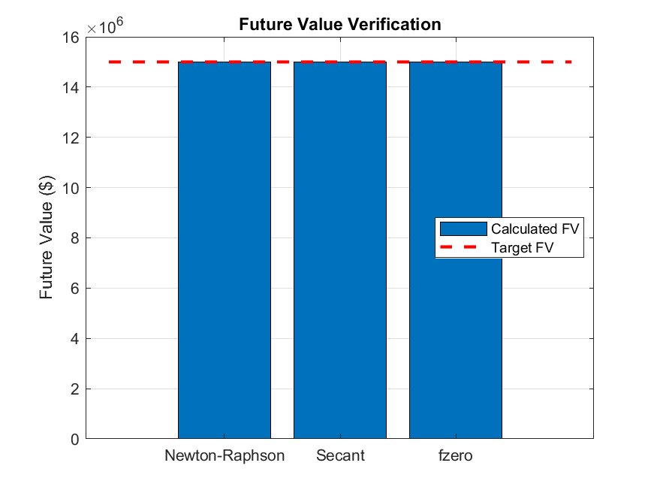
FINAL VERIFICATION
figure;
FV_newton = PV * (1 + r0/n)^(n*t);
FV_secant = PV * (1 + r_secant(end)/n)^(n*t);
FV_analytical = PV * (1 + r_analytical/n)^(n*t);
bar([FV_newton, FV_secant, FV_analytical]);
hold on;
plot([0, 4], [FV_target, FV_target], 'r--', 'LineWidth', 2);
set(gca, 'XTickLabel', methods);
ylabel('Future Value ($)');
title('Future Value Verification');
legend('Calculated FV', 'Target FV', 'Location', 'best');
grid on;
GROUP 17

Slide 12
POPULATION GROWTH
%% Real-world problem: Population growth with carrying capacity (Logistic Equation)
% dP/dt = r*P*(1 - P/K)
% Where: P = population, r = growth rate, K = carrying capacity
% Parameters
r = 0.1; % Growth rate
K = 1000; % Carrying capacity
P0 = 100; % Initial population
t_span = [0, 50]; % Time span
h = 0.1; % Step size
Problem
Calculating Population growth with carrying capacity
Using K ./ (1 + ((K - P0) / P0) * exp(-r * t))
Function
The function of the equation and its derivative
% Analytical solution
P_analytical = @(t) K ./ (1 + ((K - P0) / P0) * exp(-r * t));
GROUP 17

Slide 13
PART B. EULER'S METHOD
Euler's method is the simplest first-order numerical integration technique for ODEs. It uses the current rate of change (dt/dP​) to step forward in time:
fprintf('=== EULER''S METHOD ===\n');
tic;
t_euler = t_span(1):h:t_span(2);
P_euler = zeros(size(t_euler));
P_euler(1) = P0;
for i = 1:length(t_euler)-1
dPdt = r * P_euler(i) * (1 - P_euler(i)/K);
P_euler(i+1) = P_euler(i) + h * dPdt;
end
time_euler = toc;
GROUP 17

Slide 14
THE RUNGE-KUTTA
The Runge-Kutta 4th Order (RK4) method is a higher-order, more accurate technique. It estimates the slope using a weighted average of four estimates (k1​,k2​,k3​,k4​) across the time step h.
fprintf('=== RUNGE-KUTTA ===\n');
tic;
t_rk = t_span(1):h:t_span(2);
P_rk = zeros(size(t_rk));
P_rk(1) = P0;
for i = 1:length(t_rk)-1
k1 = r * P_rk(i) * (1 - P_rk(i)/K);
k2 = r * (P_rk(i) + 0.5*h*k1) * (1 - (P_rk(i) + 0.5*h*k1)/K);
k3 = r * (P_rk(i) + 0.5*h*k2) * (1 - (P_rk(i) + 0.5*h*k2)/K);
k4 = r * (P_rk(i) + h*k3) * (1 - (P_rk(i) + h*k3)/K);
P_rk(i+1) = P_rk(i) + (h/6) * (k1 + 2*k2 + 2*k3 + k4);
end
time_rk4 = toc;
GROUP 17

Slide 15
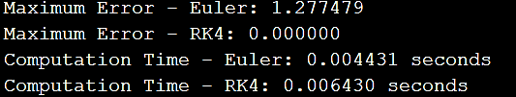
ERROR ANALYSIS OF THE TWO METHODS
Error analysis of the Euler and runge kutta method
% Error Analysis
P_analytical_values = P_analytical(t_euler);
error_euler = abs(P_euler - P_analytical_values);
error_rk = abs(P_rk(1:length(t_euler)) - P_analytical_values);
fprintf('=== ERROR ANALYSIS ===\n');
fprintf('Maximum Error - Euler: %.6f\n', max(error_euler));
fprintf('Maximum Error - RK4: %.6f\n', max(error_rk));
fprintf('Computation Time - Euler: %.6f seconds\n', time_euler);
fprintf('Computation Time - Runge kutta: %.6f seconds\n', time_rk4);
Print Results;
GROUP 17

Slide 16
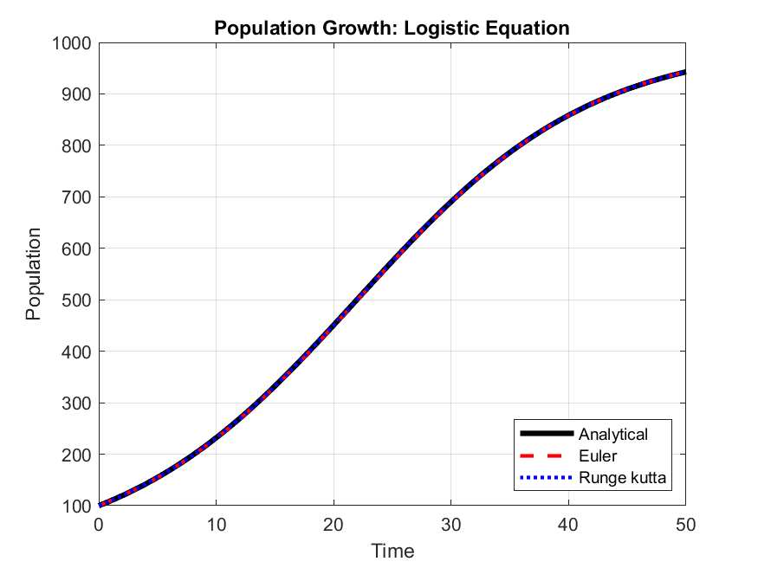
PLOTTING RESULTS FOR DIFFERENT EQUATIONS.
Population growth comparison
figure;
t_dense = linspace(t_span(1), t_span(2), 1000);
plot(t_dense, P_analytical(t_dense), 'k-', 'LineWidth', 3, 'DisplayName', 'Analytical');
hold on;
plot(t_euler, P_euler, 'r--', 'LineWidth', 2, 'DisplayName', 'Euler');
plot(t_rk, P_rk, 'b:', 'LineWidth', 2, 'DisplayName', 'Runge kutta');
xlabel('Time');
ylabel('Population');
title('Population Growth: Logistic Equation');
legend('Location', 'southeast');
grid on;
GROUP 17

Slide 17
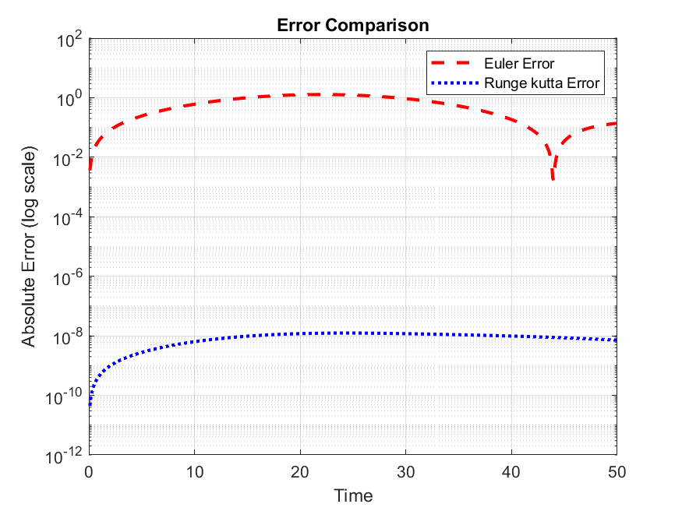
ERROR COMPARISON
figure;
semilogy(t_euler, error_euler, 'r--', 'LineWidth', 2, 'DisplayName', 'Euler Error');
hold on;
semilogy(t_euler, error_rk, 'b:', 'LineWidth', 2, 'DisplayName', 'Runge kutta Error');
xlabel('Time');
ylabel('Absolute Error (log scale)');
title('Error Comparison');
legend('Location', 'northeast');
grid on;
GROUP 17

Slide 18
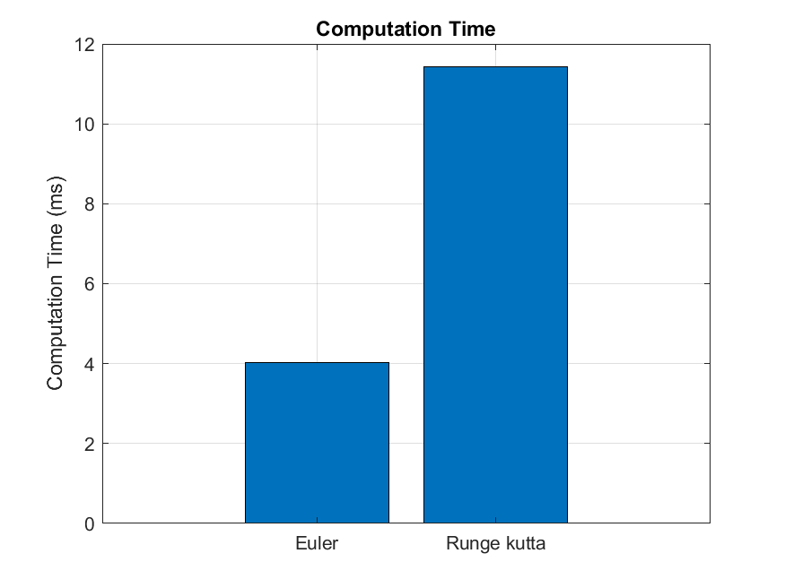
COMPUTATION TIME
figure;
methods_de = {'Euler', 'Runge kutta'};
times_de = [time_euler, time_rk4] * 1000;
bar(times_de);
ylabel('Computation Time (ms)');
title('Computation Time');
set(gca, 'XTickLabel', methods_de);
grid on;
GROUP 17

Slide 19
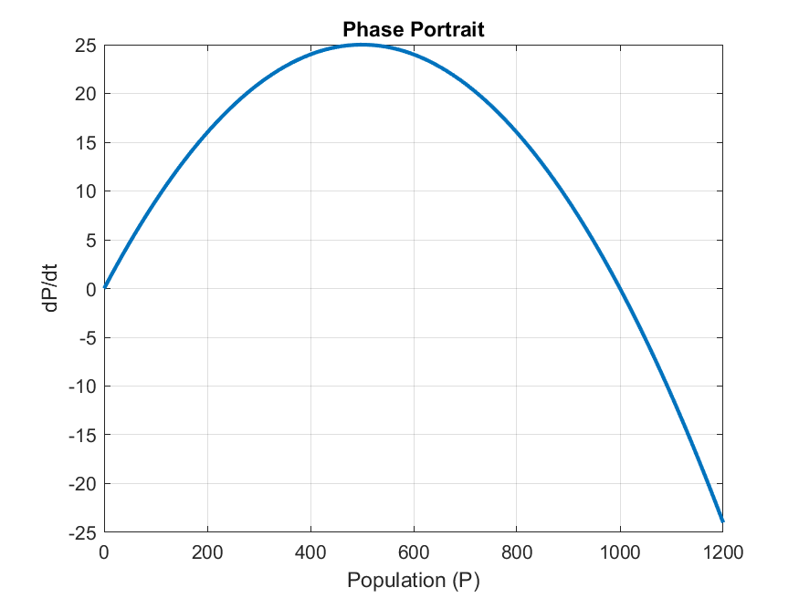
PHASE PORTRAIT
figure;
P_range = linspace(0, 1200, 100);
dPdt_range = r * P_range .* (1 - P_range/K);
plot(P_range, dPdt_range, 'LineWidth', 2);
xlabel('Population (P)');
ylabel('dP/dt');
title('Phase Portrait');
grid on;
GROUP 17

Slide 20
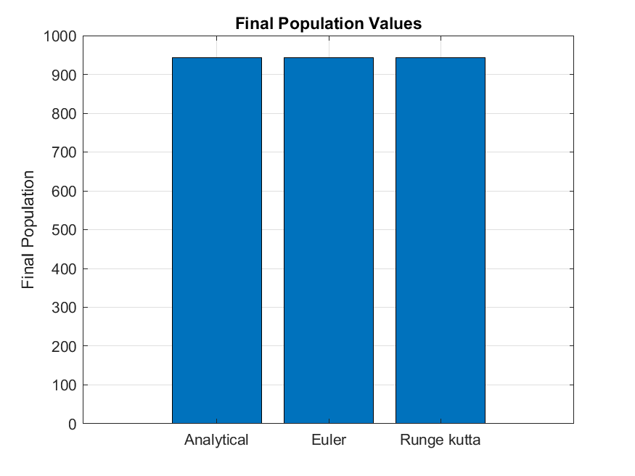
FINAL VALUES COMPARISON
figure;
final_values = [P_analytical(t_span(2)), P_euler(end), P_rk(end)];
bar(final_values);
ylabel('Final Population');
title('Final Population Values');
set(gca, 'XTickLabel', {'Analytical', 'Euler', 'Runge kutta'});
grid on;
GROUP 17

Slide 21
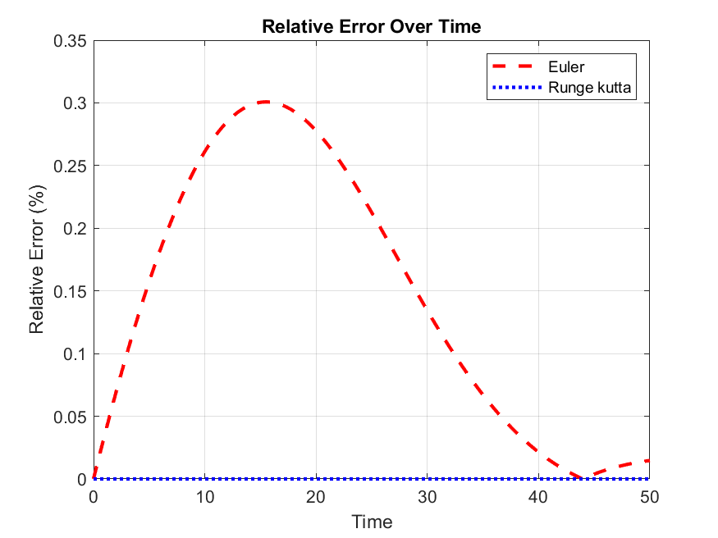
Relative error over time
figure;
relative_error_euler = error_euler ./ P_analytical_values;
relative_error_rk = error_rk ./ P_analytical_values;
plot(t_euler, relative_error_euler * 100, 'r--', 'LineWidth', 2);
hold on;
plot(t_euler, relative_error_rk * 100, 'b:', 'LineWidth', 2);
xlabel('Time');
ylabel('Relative Error (%)');
title('Relative Error Over Time');
legend('Euler', 'Runge kutta', 'Location', 'northeast');
grid on;
GROUP 17

Slide 22
Conclusion
CHALLENGES
Code optimizations issues
Limitation in Understanding complex graphics & algorithms
ACHIEVEMENTS
Success in completing a complex task.
Knowledge about solving differential equation in MATLAB.
CONCLUSION
We hope To learn more and understand the use of MATLAB
GROUP 17

Slide 23

GROUP 17

